Slide 1
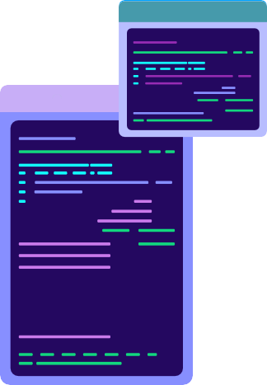

Interface
Ardiles Sinaga
Fakultas Vokasi
Institut Teknologi Del
Sitoluama, Laguboti

Slide 2
What is an Interface?
Such contracts that specify how components will interact and exchange information.
It exposes method speciﬁcation and constants.
Keyword: interface
public class Mahasiswa {
...
}

Slide 3
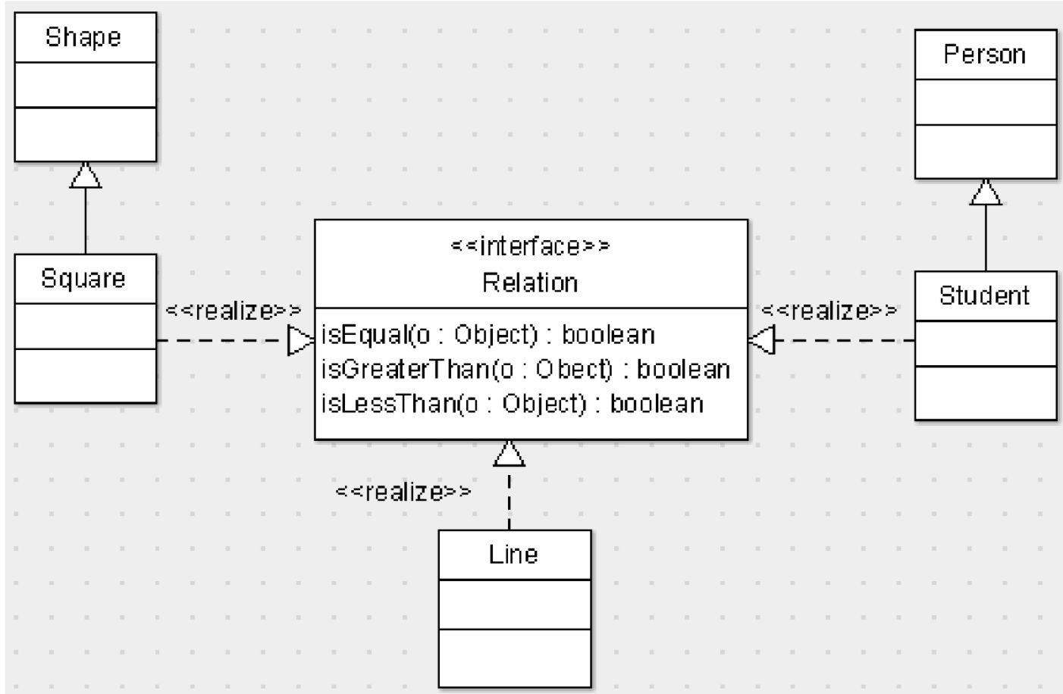
Why do we need an Interface?
As a contract to implement speciﬁc method.

Slide 4
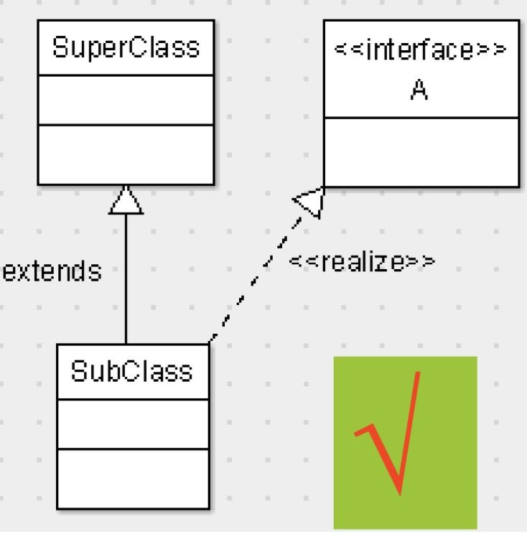
Why do we need an Interface?
Overcome the problem of multiple inheritance.
class SubClass extends SuperClass implements A{
...
}

Slide 5
Interface Characteristics
It contains only constants, method signatures, and nested types.
The access modiﬁer is automatically public.
It can't be instantiated.
All attribute in the interface is automatically ﬁnal ans static.

Slide 6
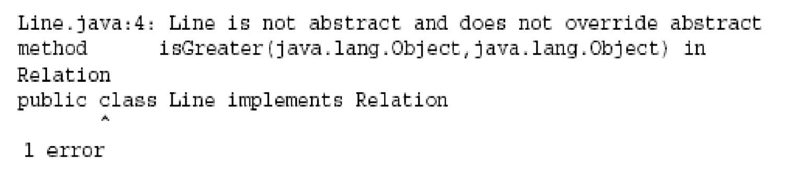
Interface Characteristics
All class which implements interface must override the all method.

Slide 7
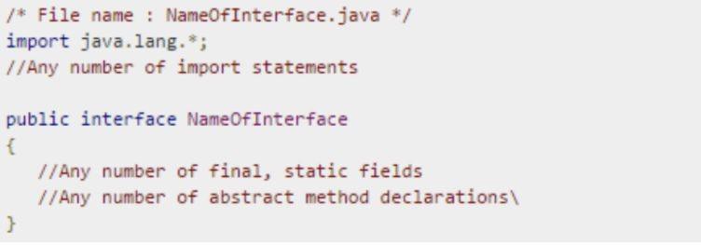
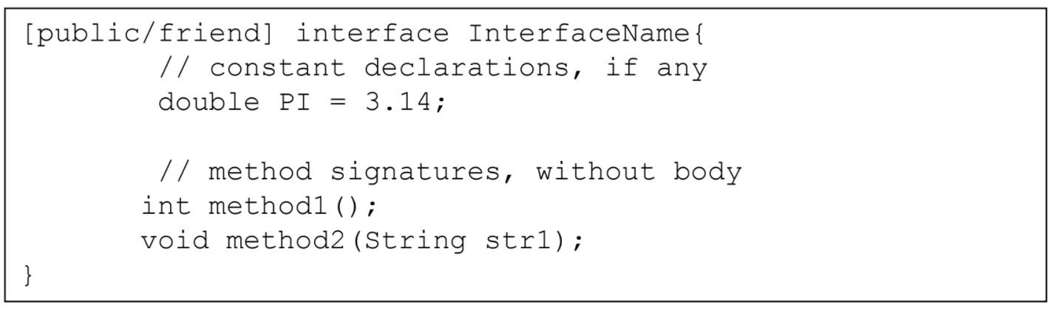
How to deﬁne an Interface?
contains only constants, method signatures, and nested types.

Slide 8
How to deﬁne an Interface?
public interface Relation {
public boolean isEqual(Object o);
public boolean isGreaterThan(Object o); public boolean isLessThan(Object o);
}

Slide 9
How to deﬁne an Interface?
The method is abstract: doesn't have body/implementation.
The modiﬁer implicitly is automatically declared as abstract.
The method in the interface implicitly is also automatically declared as abstract.
public [abstract] interface Relation {
public [abstract] boolean isEqual(Object o);
public [abstract] boolean isGreaterThan(Object o); public [abstract] boolean isLessThan(Object o);
}

Slide 10
How to implement Interface?
public class Line implements Relation{ public Line(){
//body
}
public boolean isGreater (Object o){
//body
}
public boolean isLess(Object o){
//body
}
public boolean isEqual(Object o){//body}
}

Slide 11
THANKS
Please keep this slide for attribution
CREDITS: This presentation template was created by Slidesgo, including icons by Flaticon, infographics & images by Freepik

